Slide 1
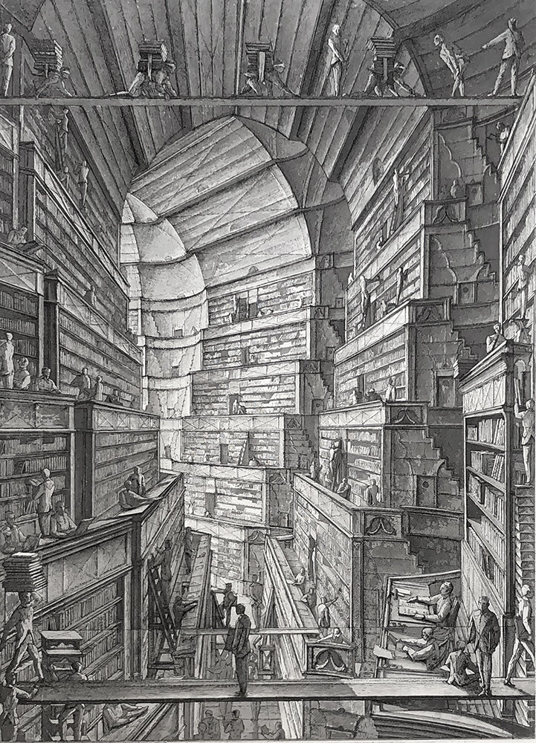
Large Language Models
Past (1980-2017) and present (2017-2024)
Alberto Lumbreras
AI Researcher
www.albertolumbreras.net

Slide 2
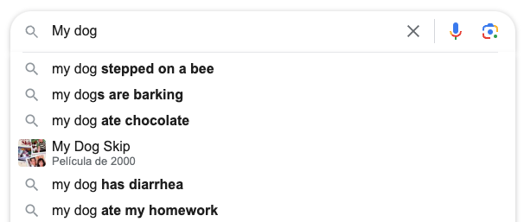
What is a language model
A model that learns the probability of each possible sentence

Slide 3

A timeline of language models
1982. RNN/Hopfield
Hopfield (1982). "Neural networks and physical systems with emergent collective computational abilities". PNAS
1995. RNN/LSTM
Hochreiter, Schmidhuber (1997). “Long Short-Term Memory”. Neural Computing Gers, Schmidhuber, Cummins (1999). "Learning to forget: Continual prediction with LSTM". ICANN
2014. RNN/LSTM/Sequence-to-sequence
Sutskever, Vinyals, Quoc (2014). “Sequence to Sequence Learning with Neural Networks.” NeurIPS
2016. RNN/LSTM/Sequence-to-sequence/Attention
Bahdanau, Cho, and Bengio. (2016). “Neural Machine Translation by Jointly Learning to Align and Translate.” ICLR.
2017. Self-Attention/Transformers
GPU
Vaswani et al. 2017. “Attention Is All You Need.” NeurIPS
Data
Parallelizable training

Slide 4
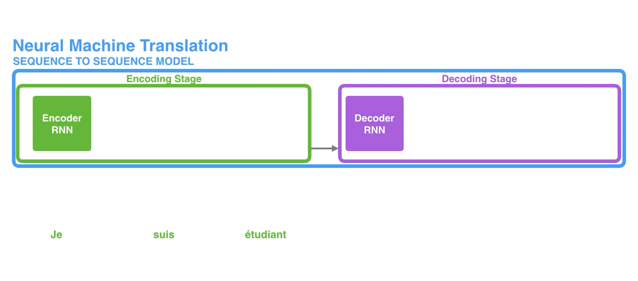
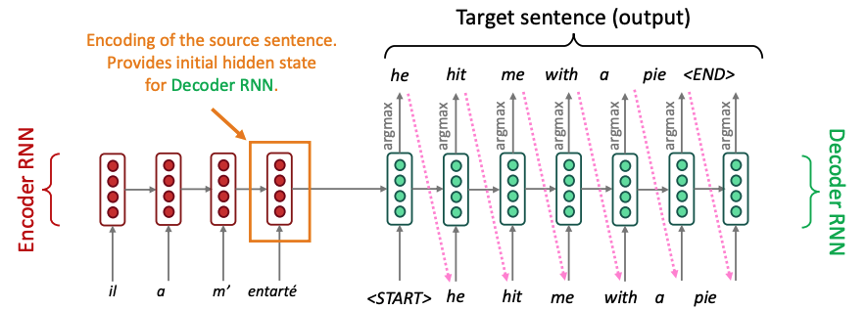
Recurrent Neural Networks / Sequence-to-Sequence (2014)
And encoder RNN and a decoder RNN
First, encode the input sentence (encoder)
Then, decode looking only at the full encoded sentence.
Encoder and decoder are RNNs
Machine Translation trained end-to-end
Decoder only sees last context vector

Slide 5
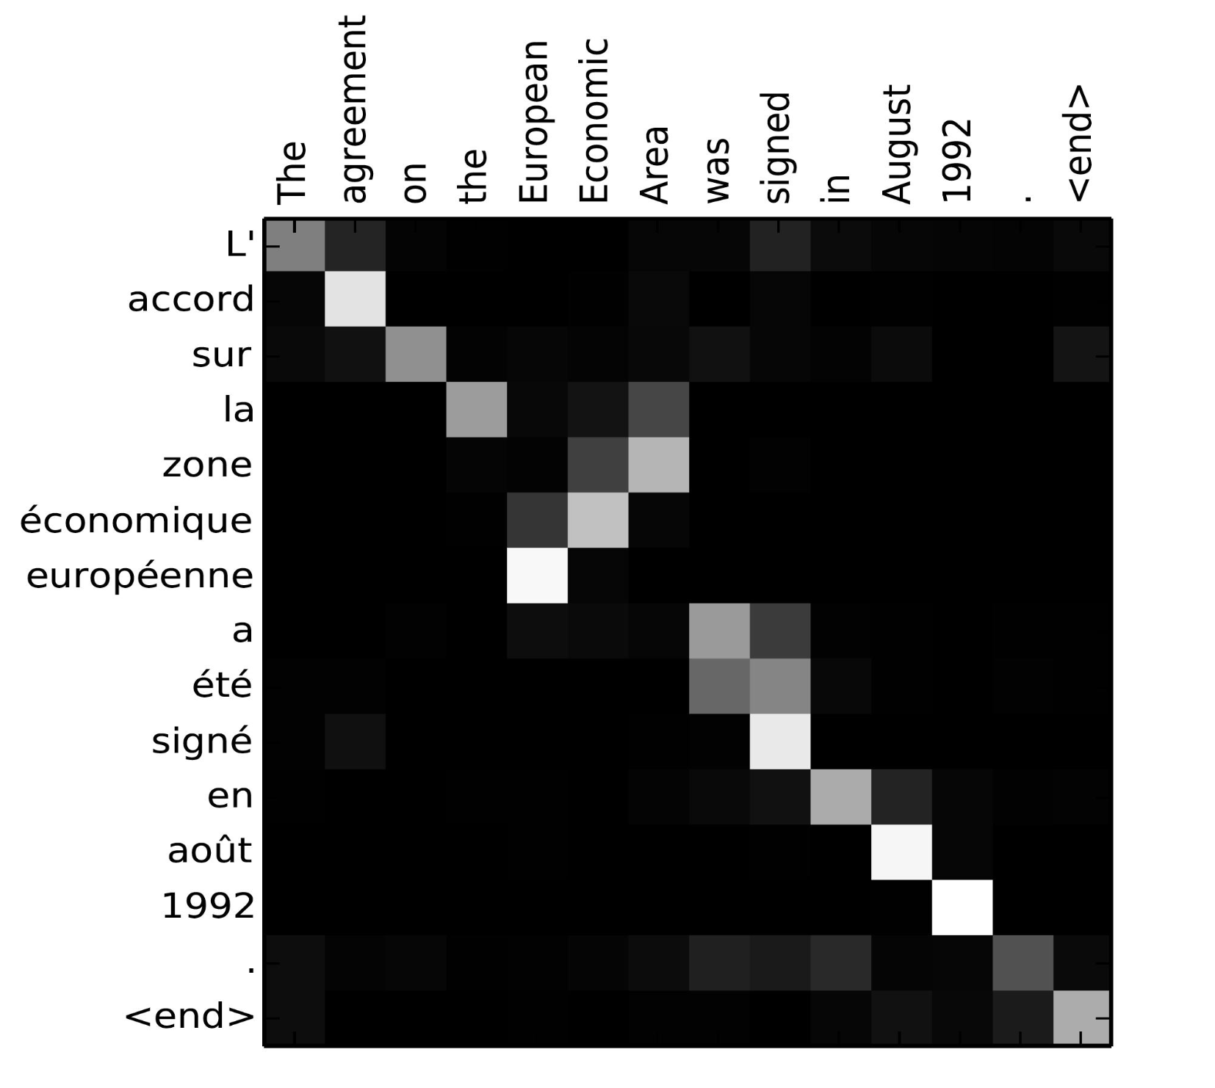
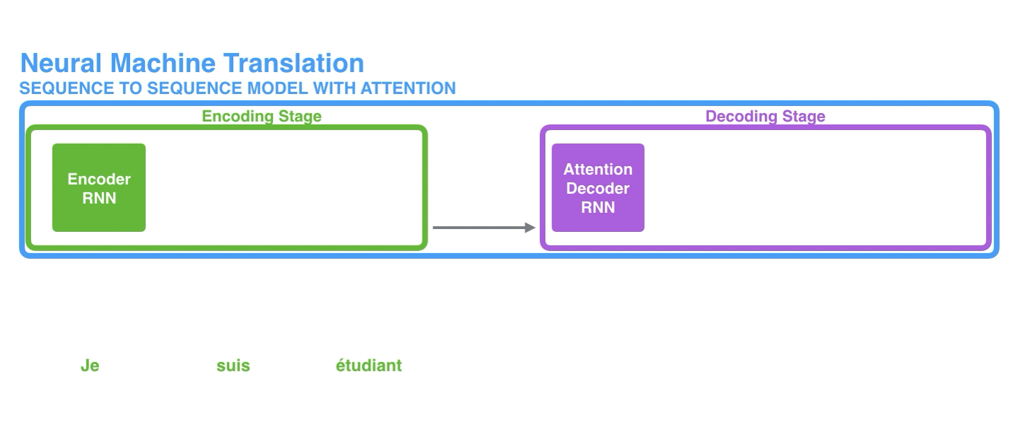
Recurrent Neural Networks / Seq2Seq / Attention (2016)
An improvement to seq2seq models for machine translation
Potentially use all encoder hidden states when decoding
Learn to decide which hidden states are more relevant at each timestep (attention)
Attention is not affected by distance
Naïve implementation needs Lx x Ly comparisons

Slide 6
A timeline of language models
Everything changed in 2017
1982. RNN/Hopfield
Hopfield (1982). "Neural networks and physical systems with emergent collective computational abilities". PNAS
1995. RNN/LSTM
Hochreiter, Schmidhuber (1997). “Long Short-Term Memory”. Neural Computing Gers, Schmidhuber, Cummins (1999). "Learning to forget: Continual prediction with LSTM". ICANN
2014. RNN/LSTM/Sequence-to-sequence
Sutskever, Vinyals, Quoc (2014). “Sequence to Sequence Learning with Neural Networks.” NeurIPS
2016. RNN/LSTM/Sequence-to-sequence/Attention
Bahdanau, Cho, and Bengio. (2016). “Neural Machine Translation by Jointly Learning to Align and Translate.” ICLR.
2017. Self-Attention/Transformers
GPU
Vaswani et al. 2017. “Attention Is All You Need.” NeurIPS
Data
Parallelizable training

Slide 7

Transformer (2017)
Good-bye RNNs. Attention is all you need
Replace RNNs by self-attention
Introduce positional encoding (since self-attention loses position information)
Stack multiple self-attention layers
Learning
100% parallelizable (no RNNs)
Me gusta el Aprendizaje Automático
I like Machine Learning
(mask so that decoder does not cheat)

Slide 8
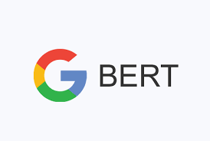


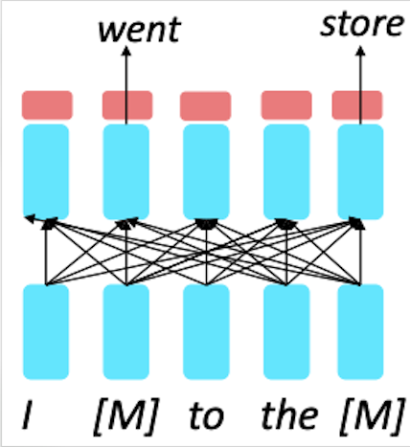
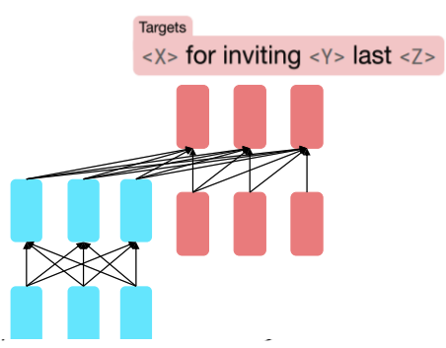
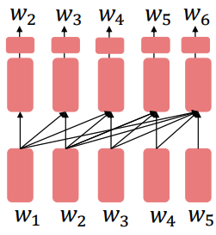
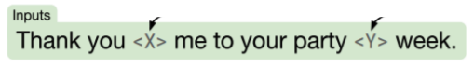
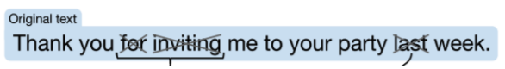
“Pre-train and fine-tuning” paradigm (2017-)
Transformers pre-trained on internet data happened to acquire some world knowledge
New trend from 2018 was to –re-train transformers on huge unsupervised datasets
Them use a (much smaller, often supervised) task-specific dataset to fine-tune the model
Encoder
Encoder-decoder
Decoder
Masked LM
Span corruption
Language model

Slide 9
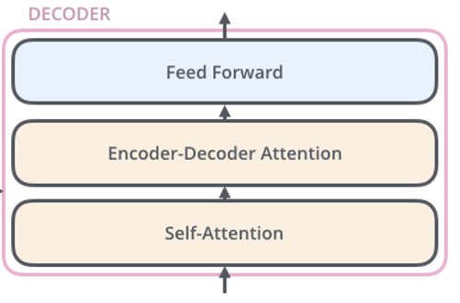
Decoders are language models
They predict next word given sentence so far
Ishmael
Call me Ishmael. Some years ago—never mind how long precisely—having little or no money in my purse, and nothing particular to interest me on shore, I thought I would sail about a little and see the watery part of the world. […]
Training corpus:
Call me Ismael […]
(mask so that decoder does not cheat)
Decoders architectures are the ones that have shown better properties
when scaling the models and the training data.

Slide 10
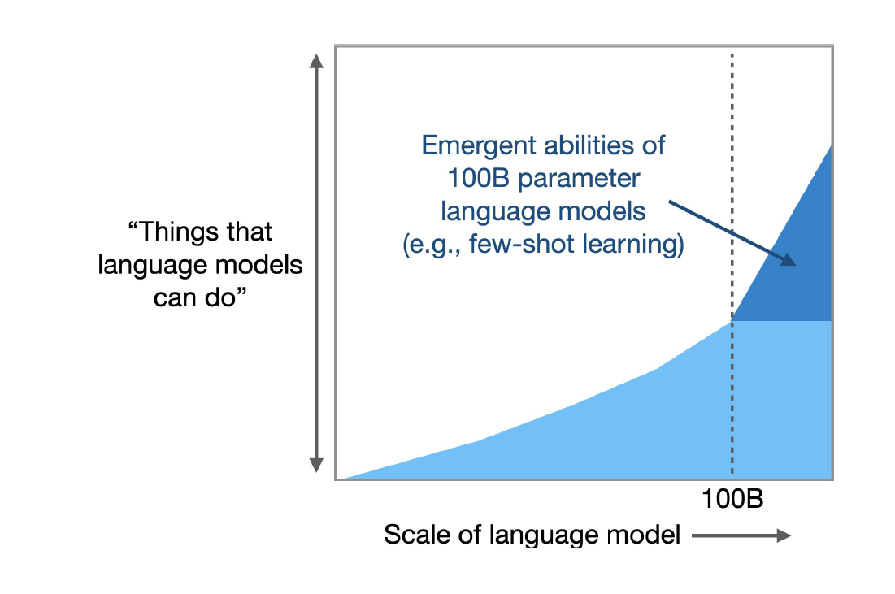
Emerging properties, towards generative multi-task models

Slide 11
A timeline of (some) large language models (decoders)
2019. GPT-2
1.5B params
40GB of text
Radford et al (2019) Language Models are Unsupervised Multitask Learners”. Tech report
2020. GPT-3
175B params
570GB of text
Brown,…,Radford, Sutskever, Amodei. (2020). “Language Models Are Few-Shot Learners”. NeurIPS
2023. GPT-3/ChatGPT
Ouyang, et al. (2022). “Training Language Models to Follow Instructions with Human Feedback.” NeurIPS [InstructGPT]
2023. LLaMA2
Touvron, Scialom, et al (2023). “Llama 2: Open Foundation and Fine-Tuned Chat Models”. Tech report.
2023. Mistral
Lample et al. (2023). “Mistral 7B.” Tech report.

Slide 12

GPT-2: Zero-shot prompting
Creative use of prompts for summarizatiom, translation, Q&A…
Model Input
Taming Transformers. The transformer architecture is astonishingly powerful but notoriously slow. Researchers have developed numerous tweaks to accelerate it — enough to warrant a look at how these alternatives work, their strengths, and their weaknesses. The attention mechanism in the original transformer places a huge burden on computation and memory; O(n²) cost where n is the length of the input sequence. As a transformer processes each token (often a word or pixel) in an input sequence, it concurrently processes — or “attends” to — every other token […]
TL;DR
1.5B parameters
40GB dataset

Slide 13

GPT-3: In-context learning (a.k.a. few shot)
Learn from examples in the prompt
Model Input
Aplep -> Apple
Banaan -> Banana
Ohuse ->
Model Output
175B parameters
600GB dataset
House

Slide 14
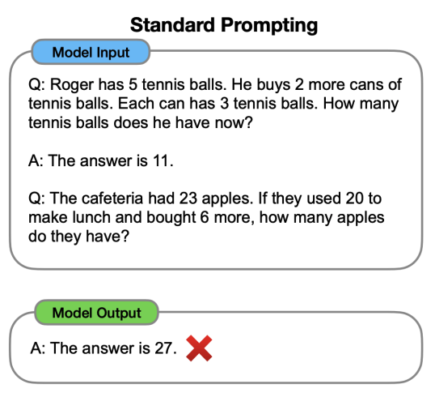
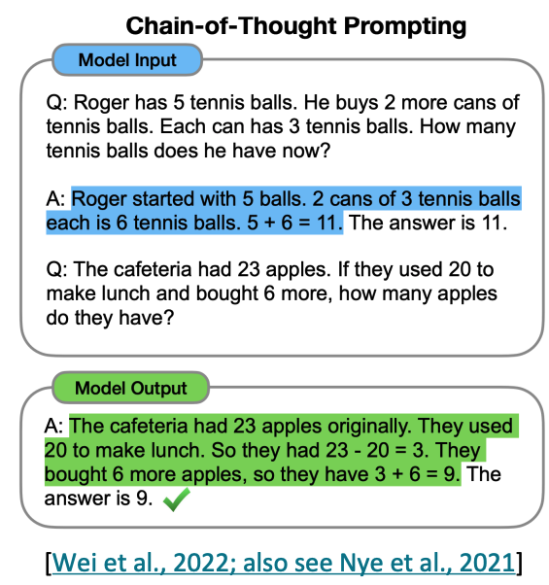
GPT-3: Chain of thought prompting
Emergence property from a given size S (S depends on the model)

Slide 15
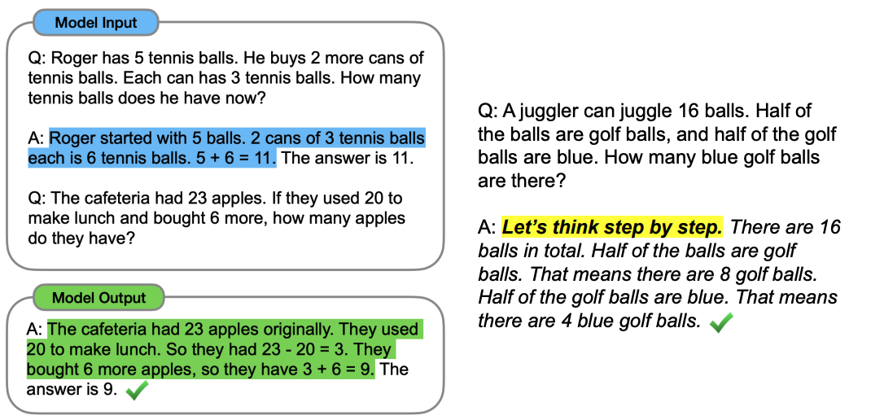
GPT-3: Zero-shot chain of thought prompting
Emergence property from a given size S (S depends on the model)

Slide 16
The era of instruction fine-tuning and “alignment” (2023-)
2019. GPT-2
1.5B params
40GB of text
Radford et al (2019) Language Models are Unsupervised Multitask Learners”. Tech report
2020. GPT-3
175B params
570GB of text
Brown,…,Radford, Sutskever, Amodei. (2020). “Language Models Are Few-Shot Learners”. NeurIPS
2023. GPT-3/ChatGPT
Ouyang, et al. (2022). “Training Language Models to Follow Instructions with Human Feedback.” NeurIPS [InstructGPT]
2023. LLaMA2
Touvron, Scialom, et al (2023). “Llama 2: Open Foundation and Fine-Tuned Chat Models”. Tech report.
2023. Mistral
Lample et al. (2023). “Mistral 7B.” Tech report.

Slide 17
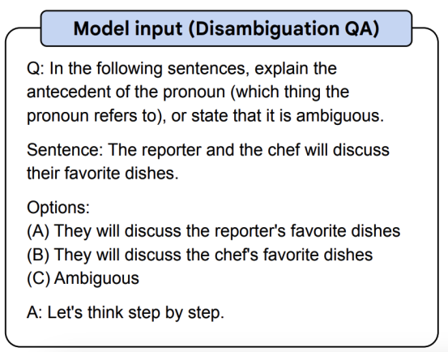
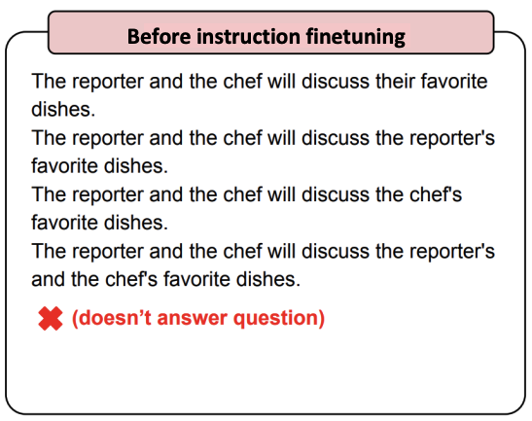
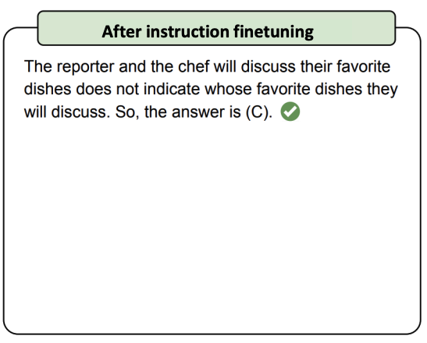
Instruction fine-tuning
Supervised training from human-labeled data for alignment with human intent
Collect examples of (instruction, output) pairs across many tasks and finetune an LM
Many possible good answers
The loss function at token level, not how a human would judge (“avatar is a movie” vs “avatar is a film”)

Slide 18
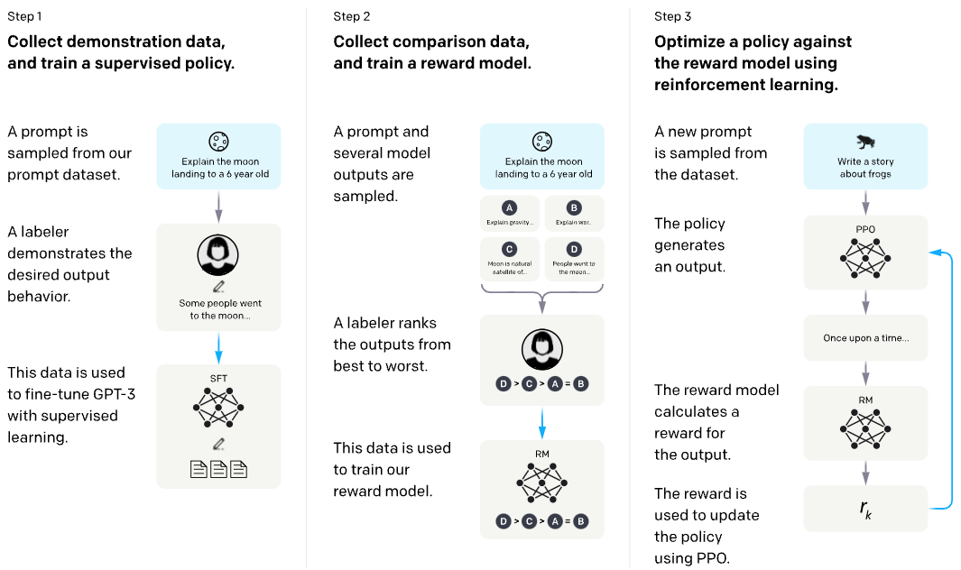
Alignment: Reinforcement Learning from Human Feedback
After instruction fine-tuning, align with human preferences

Slide 19
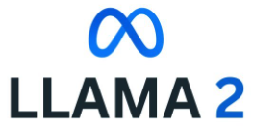
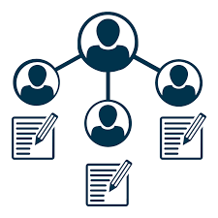

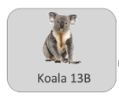
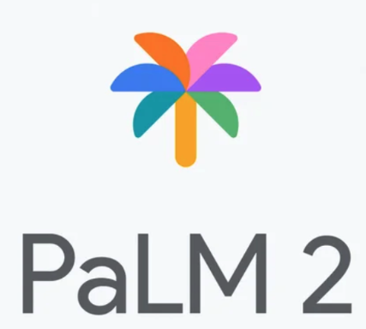


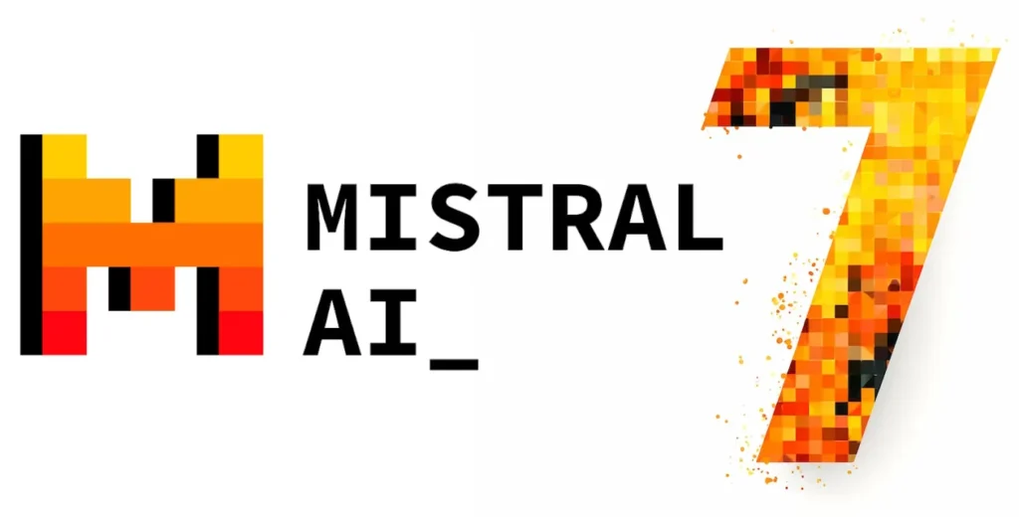
Choosing how far we need to go
Depends on needs, data, and resources
Aligned to human preferences (rankings) (a.k.a. RLHF)
General + specialized knowledge
Task-oriented
Higher quality
+
+
=
Chat
Pre-trained model
Annotated data
Human ranking data
Supervised fine-tuned (a.k.a. instruction fine-tuned)
+
=
General + specialized knowledge
Task-oriented
Pre-trained model
Annotated data
Pre-trained model
General knowledge
Performs tasks if prompted properly

Slide 20
Instruction fine-tuning
Supervised training from human-labeled data for alignment with human intent
Collect examples of (instruction, output) pairs across many tasks and finetune an LM
Many possible good answers
The loss function at token level, not how a human would judge (“avatar is a movie” vs “avatar is a film”)

Slide 21
Alignment: Reinforcement Learning from Human Feedback
After instruction fine-tuning, align with human preferences

Slide 22
Choosing how far we need to go
Depends on needs, data, and resources
Aligned to human preferences (rankings) (a.k.a. RLHF)
General + specialized knowledge
Task-oriented
Higher quality
+
+
=
Chat
Pre-trained model
Annotated data
Human ranking data
Supervised fine-tuned (a.k.a. instruction fine-tuned)
+
=
General + specialized knowledge
Task-oriented
Pre-trained model
Annotated data
Pre-trained model
General knowledge
Performs tasks if prompted properly
22

Slide 23
Fine-tuning big models always costs money
Fine-tune through API
No
Open-source
Fine-tune in cloud (GCP, Azure)
No
Yes
GPUs available
Yes
Fine-tune locally (LoRA)

Slide 24
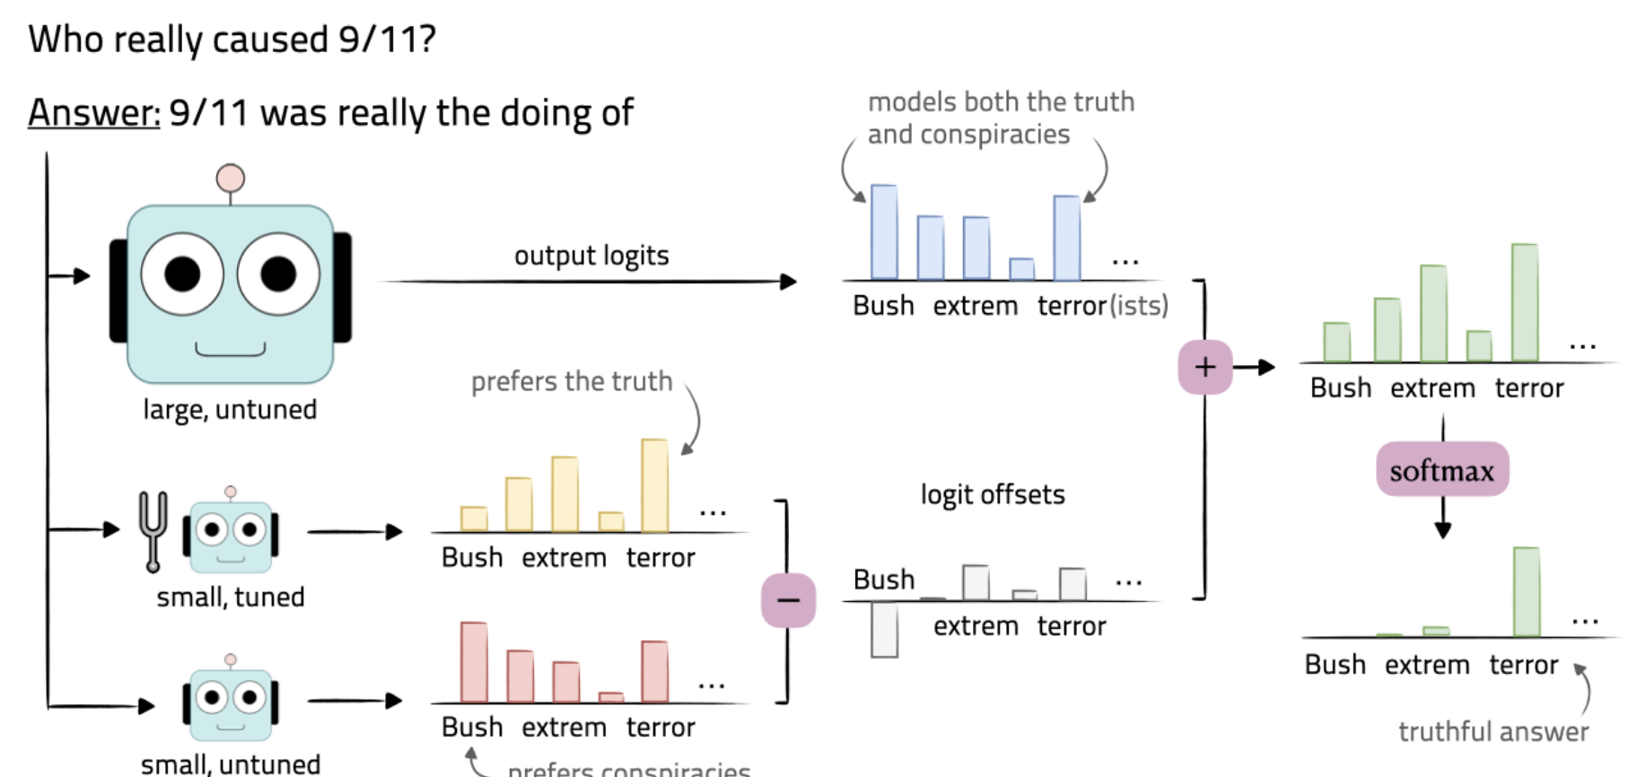
But cheaper alternatives are emerging
Proxy-tuning: fine-tune smaller models to guide the big one
Original probabilities
Offset applied at decoding time

Slide 25
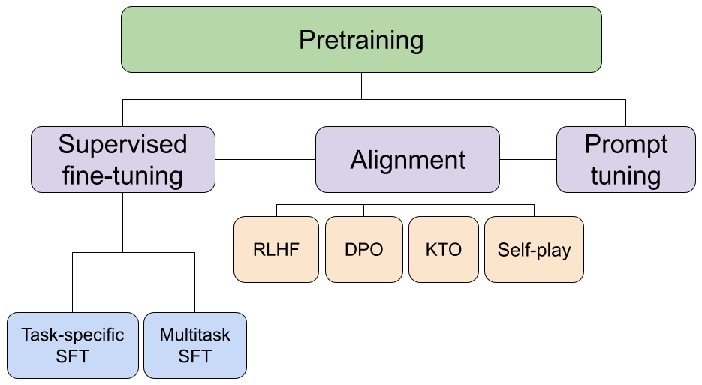
Alignment techniques are also improving
RLHF was too hard to train (instabilities in training)

Slide 26
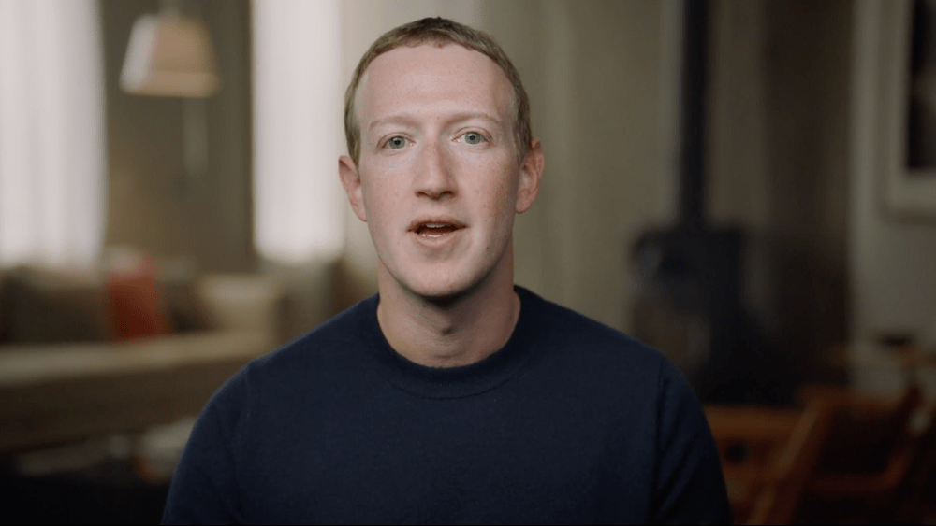
The value of data
On open-sourcing LLAMA2
I know that some people have questions about how we benefit from open sourcing the results of our research and large amounts of compute […]. The short version is that open sourcing improves our models, and because there's still significant work to turn our models into products, […] and it doesn't remove differentiation from our products much anyway.
And again, we typically have unique data and build unique product integrations anyway, so providing infrastructure like Llama as open source doesn't reduce our main advantages.
META Q4 2023 Earnings Call February 1st, 2024

Slide 27
www.albertolumbreras.net
Illustration by Erik Desmazires

Slide 28
We didn’t talk about…
Word embeddings
Mixtures of experts
Prompt jailbreaking
Evaluation metrics for LLMs
Multimodality
Hallucinations
LLMs as evaluators
The race open-source vs. proprietary
Data sources used in LLM
LLMs to augment datasets
4-bit quantization
Sam Altman
…
Notes:
How it works.
- The system is based on what we call Retrieval-Augmented Generative Recommendation. It combines parts of our recommender system with some internal LLMs that are in charge of understanding the conversation and improving the recommendation.
- FIRST: the user sends a query.
- The query and all the previous conversation is processed by a summarizer that creates a simple product query.
- This product query is then converted into a mathematical representation (and embedding) that is compared with the mathematicaml representation the products in a ctaalog.
The closest products are return, and this list is snt to a second LLM that will create a text to t present the products and will filter some products in case it considers they arenot safe or aligned with what the user wants.

Slide 29

Recurrent Neural Networks
Neural nets for flexible input and output lengths
Hidden state represents sentence so far
Update hidden state based after new input.
Output only depends on the hidden state
Flexible input/output sequence length.
Easy to code.
Recent inputs over-represented w.r.t old inputs (“vanishing gradient”)
Expensive to train (and unparallelizable)
Notes:
- Since the publication of ChatGPT some months ago, retailers such as are adding or upgrading their chatbots in their websites.
- In the following years, or months, we expect a part of the retailer’s traffic to shift from keyword search and navigation to chatbots.
- In the InBot Media project, we aredeveloping the technology to integrate our ads into these conversations.
- Our key ingredients are two: our huge commerce data, and our AI models, some of them already in production, and some of them that we are developing.
- As a first step, we are focused two aspects:
on understanding the dialog between the user and the chatbot and
integrate sponsored products among the organic results.

Slide 30
Attention masks in transformers
Encoder self-attention and decoder self-attention require different attention masks
Training
example:
Me gusta el Aprendizaje Automático
I like Machine Learning
Learning
Only sees
tokens to the left (goal: encode left-side words to predict next one)
Sees the full sentence
(goal: create a sentence representation)
Me gusta el Aprendizaje Automático
I like Machine Learning
(mask so that decoder does not cheat)

Slide 31
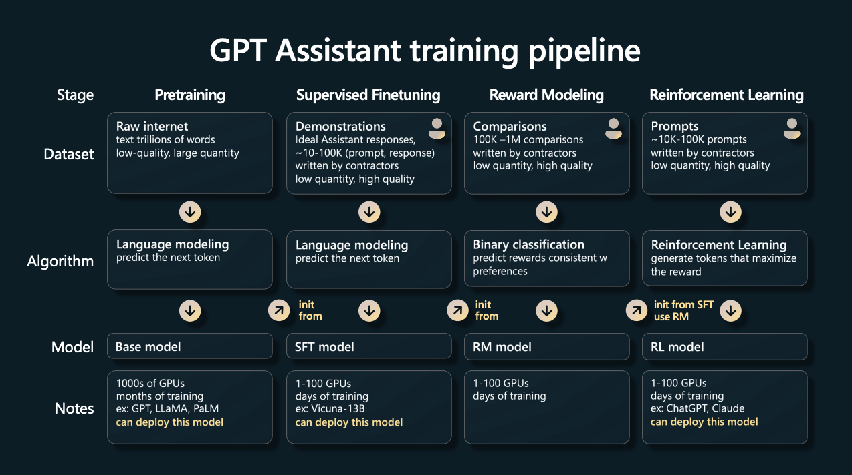
Notes:
Here as a

Slide 32
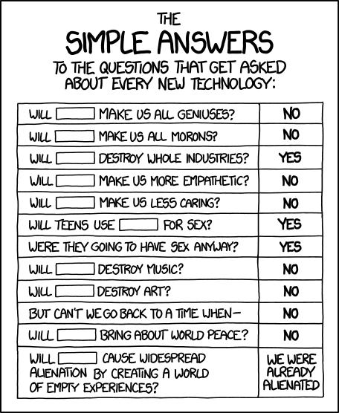
Notes:
As I said, you can already play the the current demo in our Virtual Showroom.
Our biggest efforts are now focused on improving the quality of the matching between a conversation and a product. That means re-thinking the way how we create the embeddings.
Another thing we want to do is to start collecting user feedback, to measure the quality of our models but also to re-train them.
Another challenge is to align the system to each catalog. For instance, if the user inputs healthy breakfast, we need to create representations that are adapted to the catalog. The embedding of a healthy breakfast for people shouldn’t be the same as the embedding of a healthy breakfast for epets.
Lastly, we plan to add user signals into the system so that the recommendations are more personalized.

